Slide 1
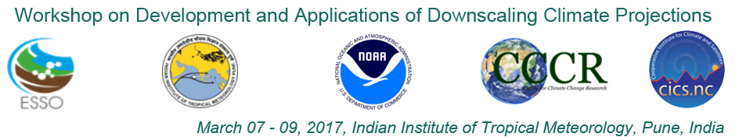
http://cccr.tropmet.res.in/home/workshop/indo-us2017/
Downscaled Climate Projections for South Asia
J. Sanjay
(with inputs from CORDEX Team Members)
Centre for Climate Change Research (CCCR)
Indian Institute of Tropical Meteorology (IITM)
Earth Science System Organisation (ESSO)
Ministry of Earth Sciences (MoES)
Government of India

Slide 2
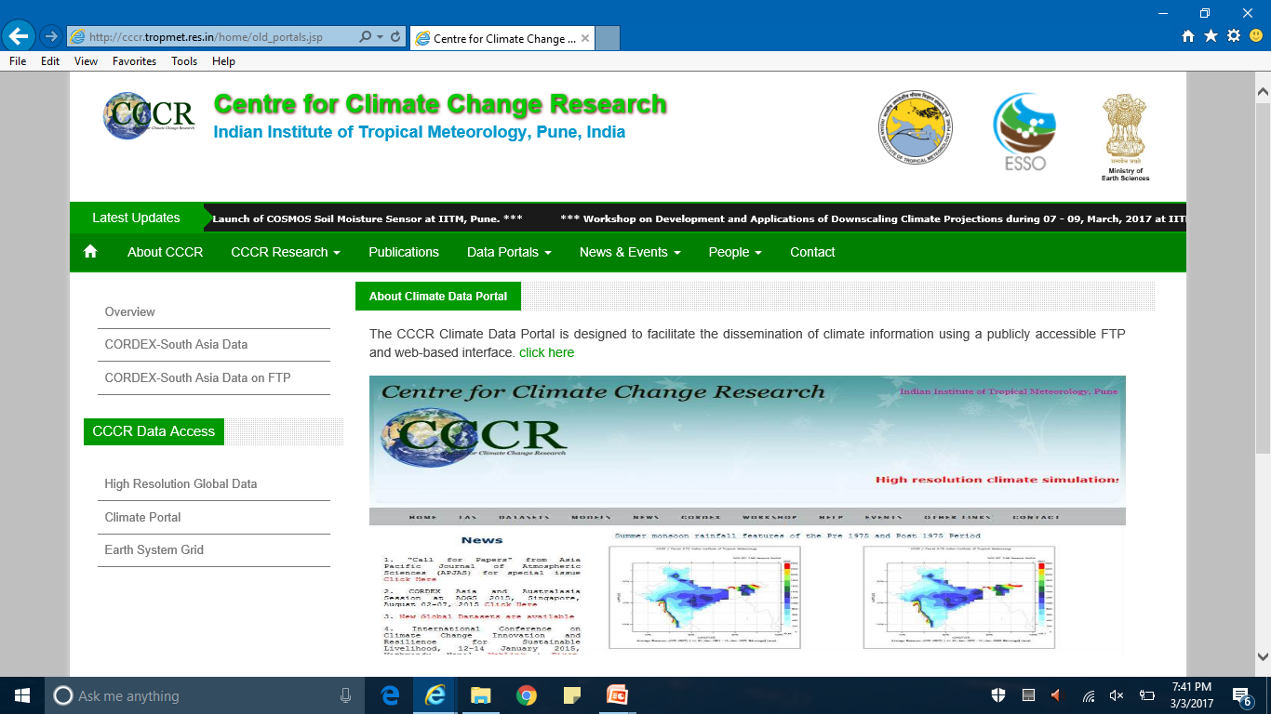
http://cccr.tropmet.res.in
CCCR aim to better understand the science of climate change over the Tropics and enable improved assessments of the regional climate responses to global climate change
CCCR has the mandate of developing an Earth System Model (ESM) and to make the regional climate projections, in addition to work on Paleoclimatology and Greenhouse Gas (GHG) measurements

Slide 3
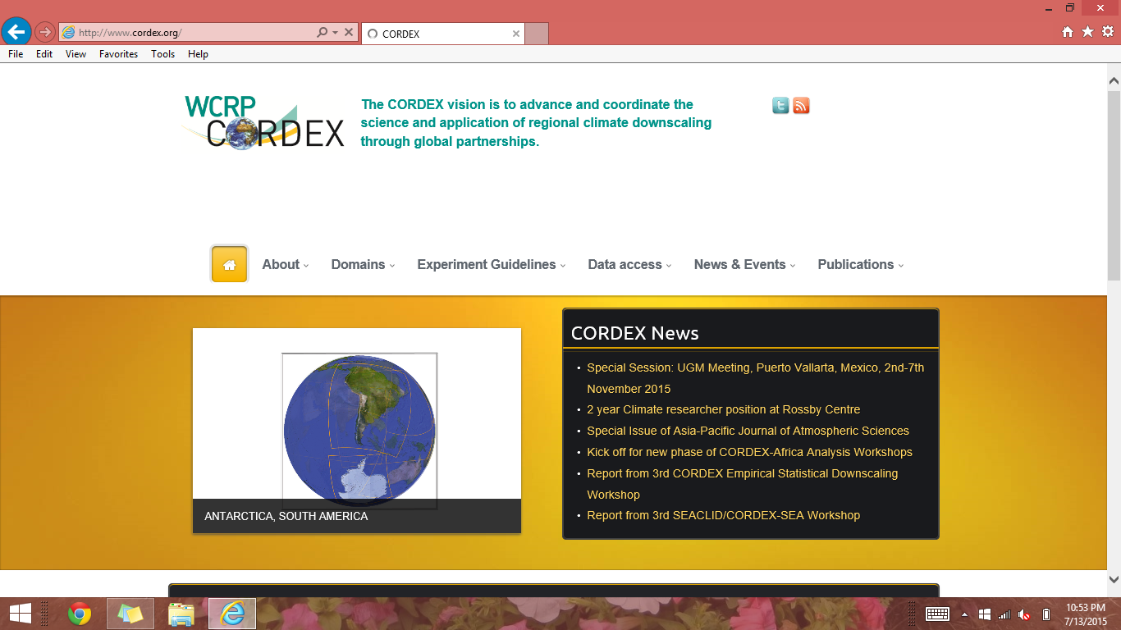
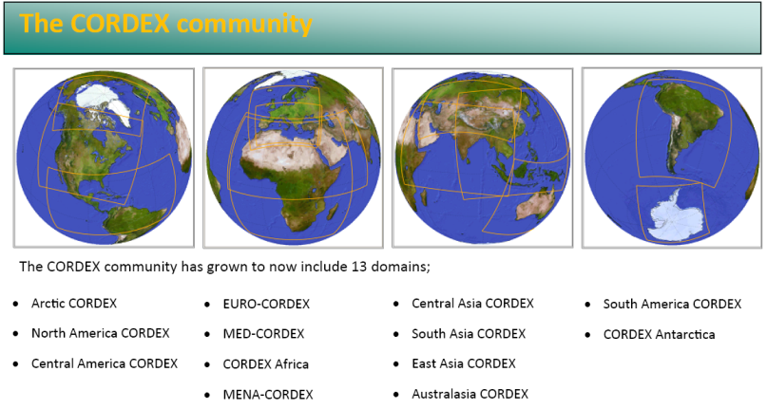
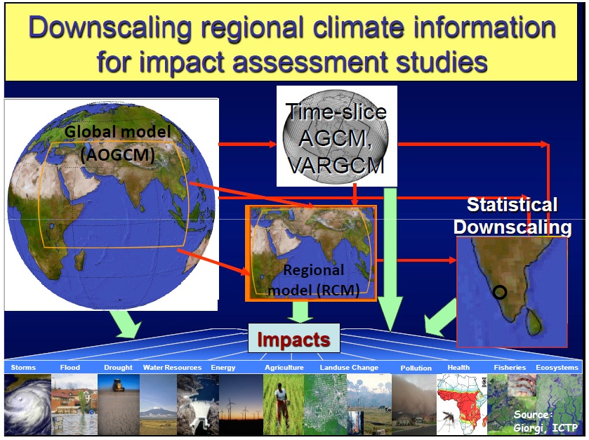
Regional Climate Information for Application Studies
CORDEX South Asia
http://www.cordex.org/
CCCR is leading CORDEX (Coordinated Regional Climate Downscaling Experiment) over South Asia Region
High Resolution (50 km) Dynamical Downscaling of CMIP5 Climate Projections based on RCP Scenarios during 1950-2100 using multiple RCMs
  More information for CORDEX South Asia data access from CCCR-IITM Climate Data Portal and ESGF datanode are provided at: http://cccr.tropmet.res.in/home/cordexsa_datasets.jsp

Slide 4
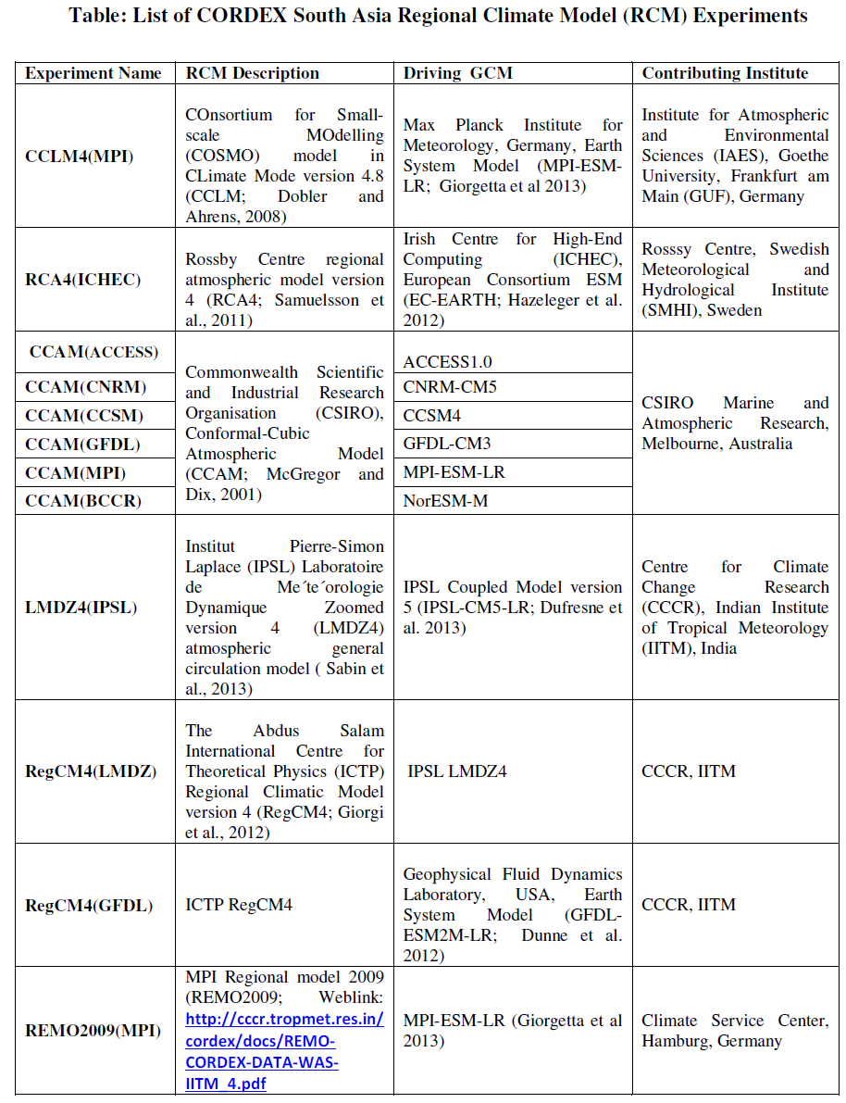
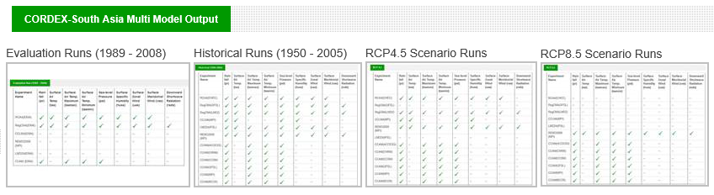
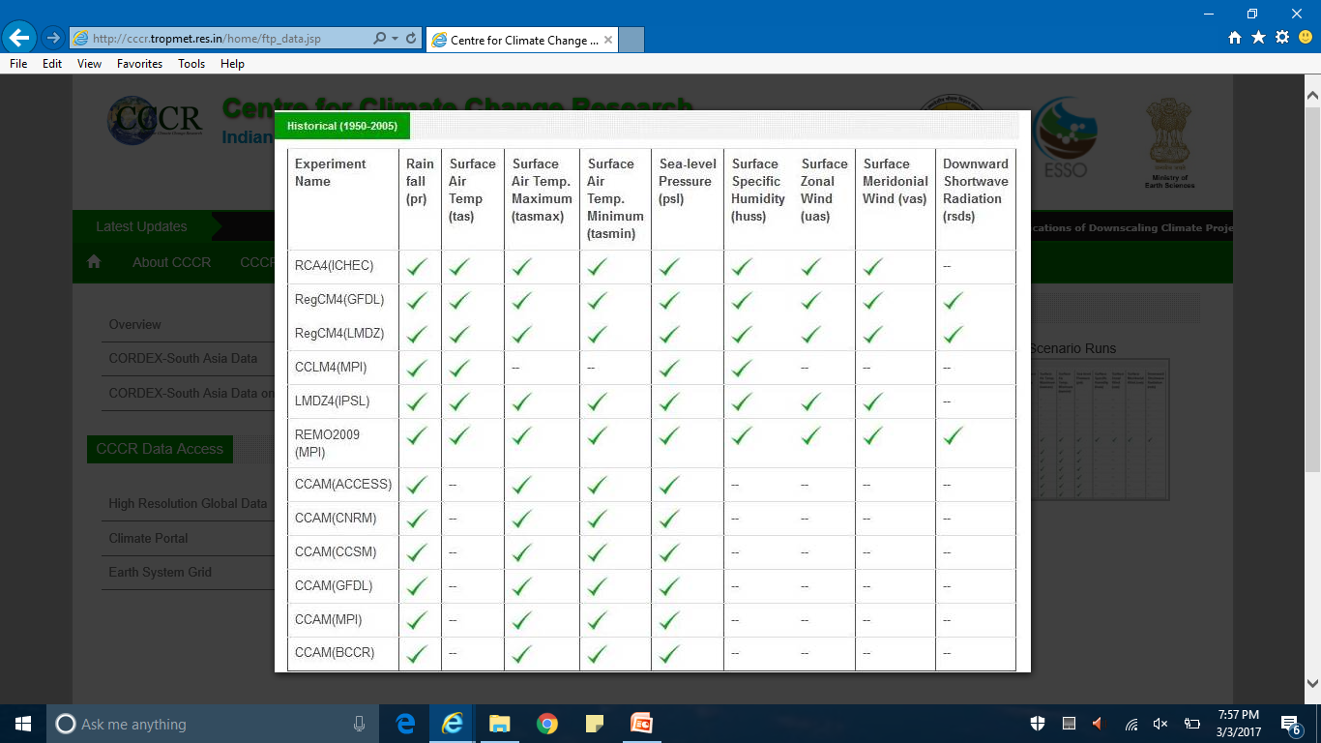
Thanks to:
S. Ingle
M. Mujumdar
  CORDEX South Asia data (50km) is available on the
  CCCR-IITM Climate Data Portal (non-ESGF):
http://cccr.tropmet.res.in/home/old_portals.jsp
http://cccr.tropmet.res.in/home/ftp_data.jsp
http://cccr.tropmet.res.in/home/docs/cordex/Table_CORDEX_Expts_all.doc

Slide 5
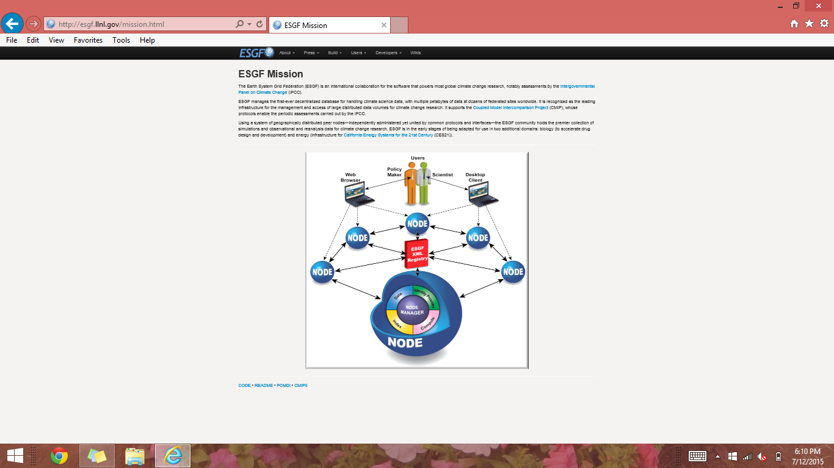
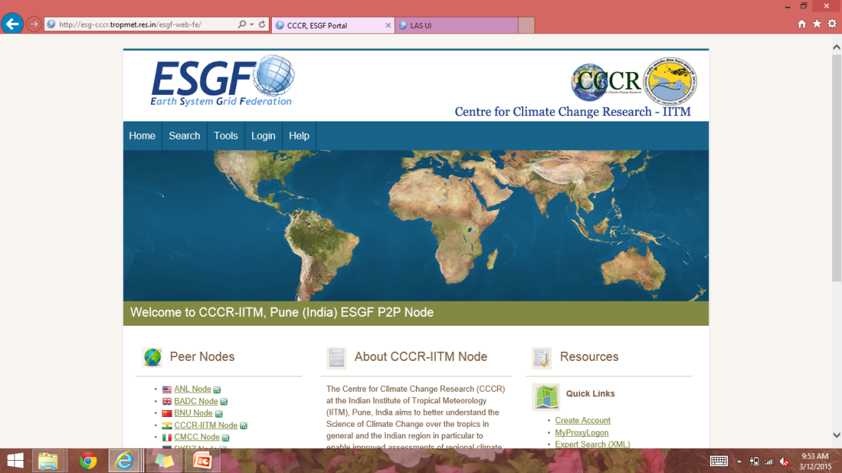
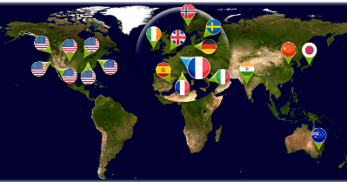
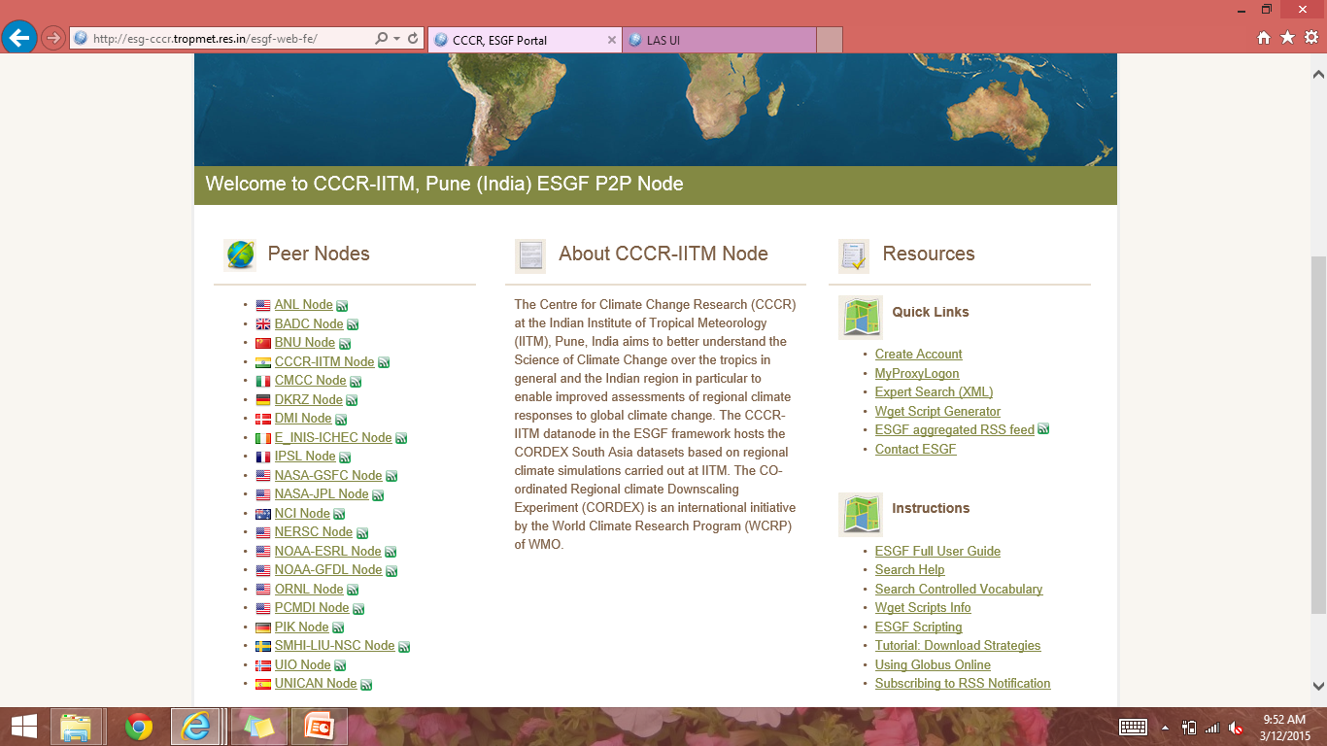
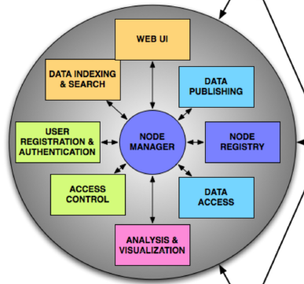
  Development of CCCR-IITM Earth System Grid Federation (ESGF) node
    Archival, Management, Retrieval and Dissemination of
    CORDEX South Asia and CMIP6 datasets
Thanks to:
Sandip Ingle, R.Mahesh
(CCCR, IITM)
Prashanth Dwarakanath
(NSC, SMHI)
Nikulin Grigory
(SMHI)
ESGF is an international collaboration for the software that powers most global climate change research, notably assessments by the IPCC
Using a system of geographically distributed peer nodes—independently administered yet united by common protocols and interfaces—the ESGF community holds the premier collection of simulations and observational and reanalysis data for climate change research
http://esgf.llnl.gov/mission.html

Slide 6

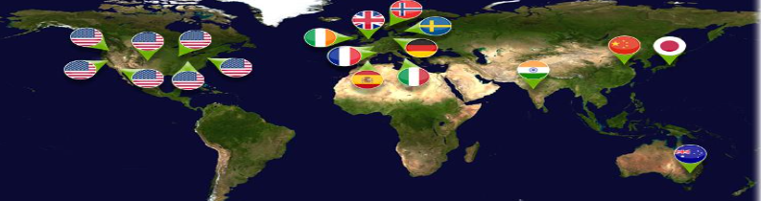
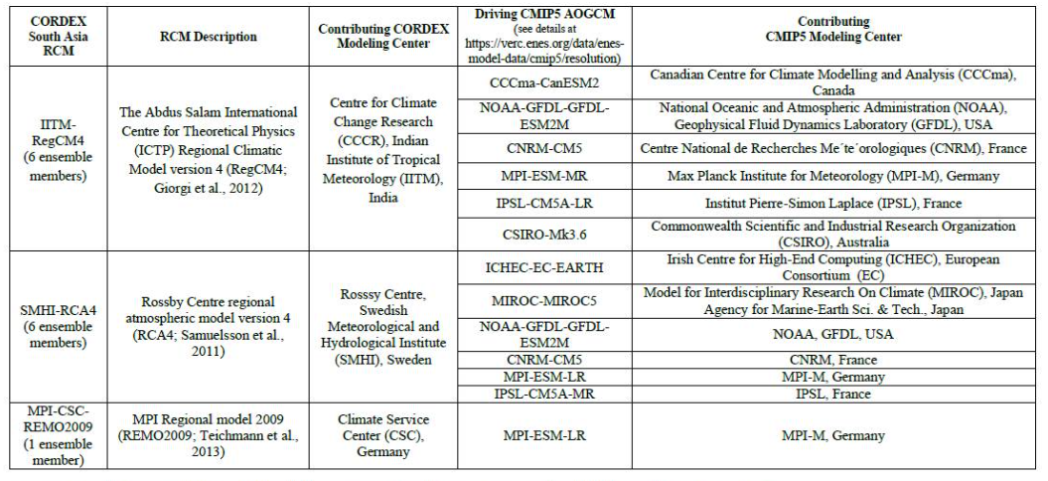
The quality checked CORDEX-South Asia Data are published on
the CCCR-IITM Earth System Grid Federation (ESGF) Data Node
The ESGF maintains a global system
of federated data centers that
allow access to the largest archive
of climate data world-wide
http://cccr.tropmet.res.in/home/cordexsa_datasets.jsp

Slide 7
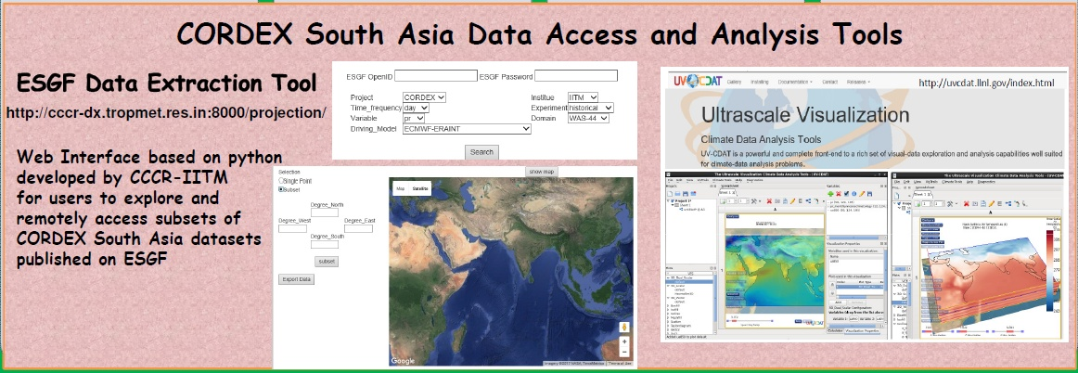

Slide 8
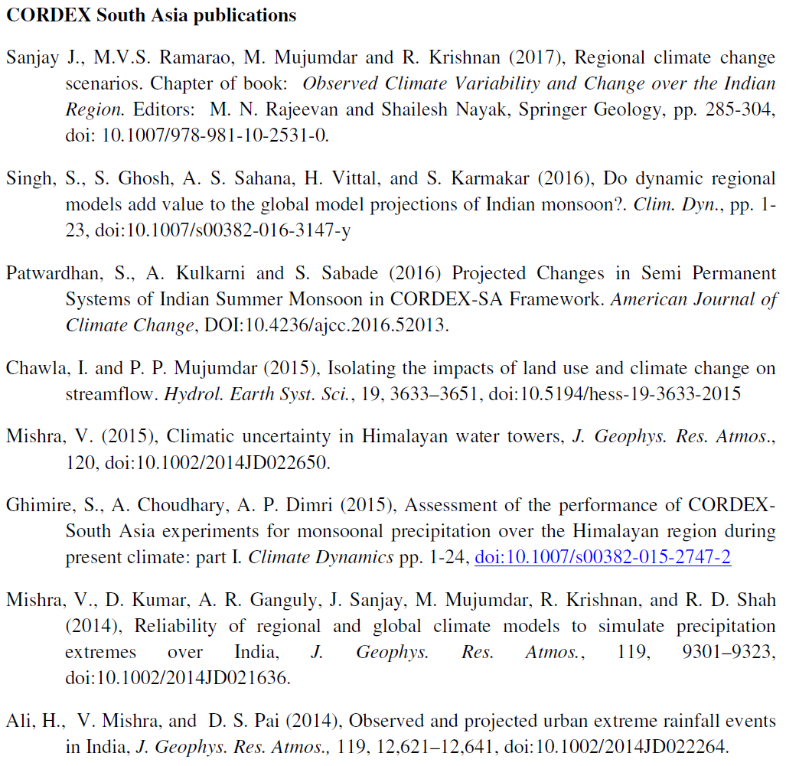

Slide 9
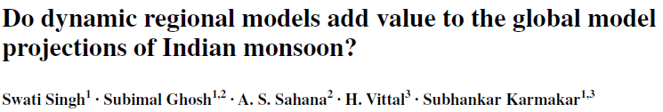

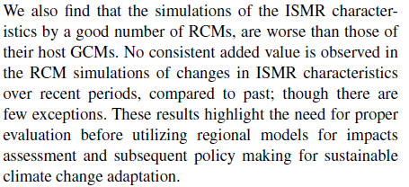
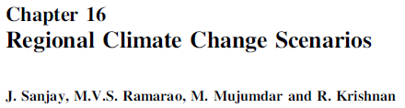

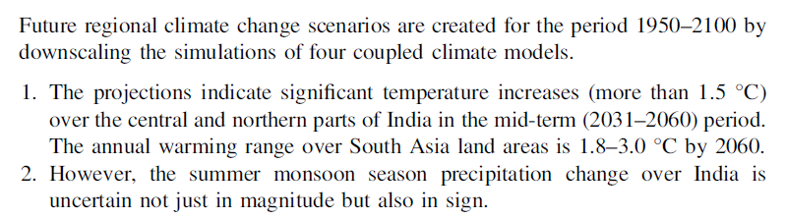
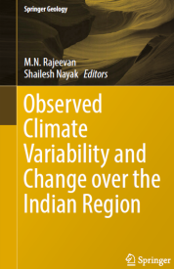

Slide 10
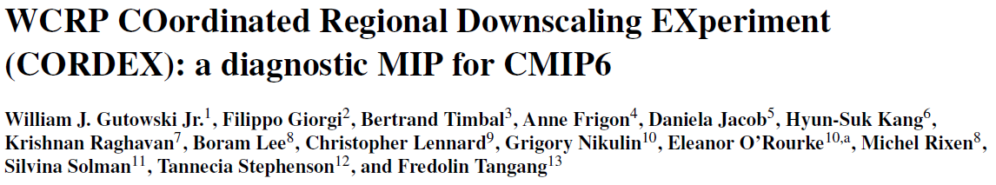

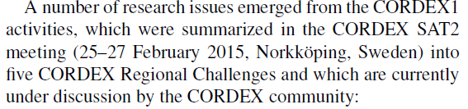
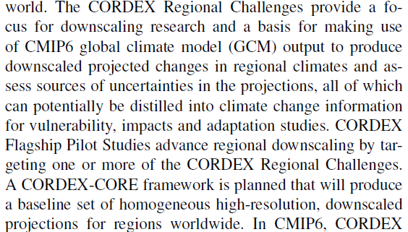
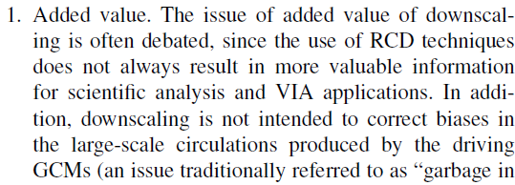



Slide 11
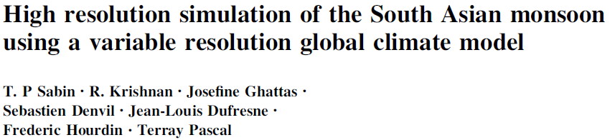

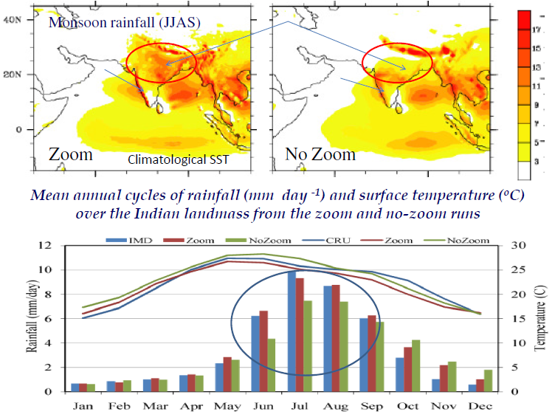


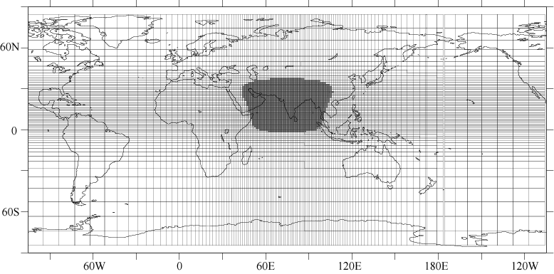
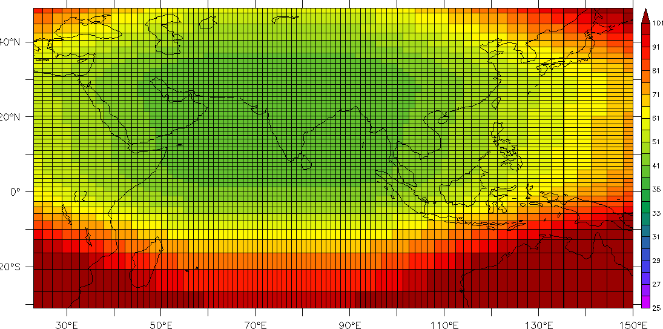
Laboratoire de Météorologie Dynamique, France, Global Climate Model (LMDZ4) having high-resolution telescopic zooming (horizontal grid size ~35 km) over South-Asia

Slide 12
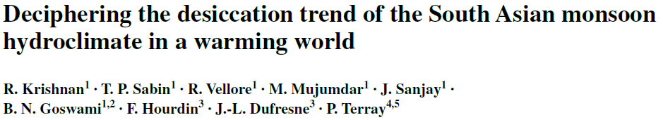
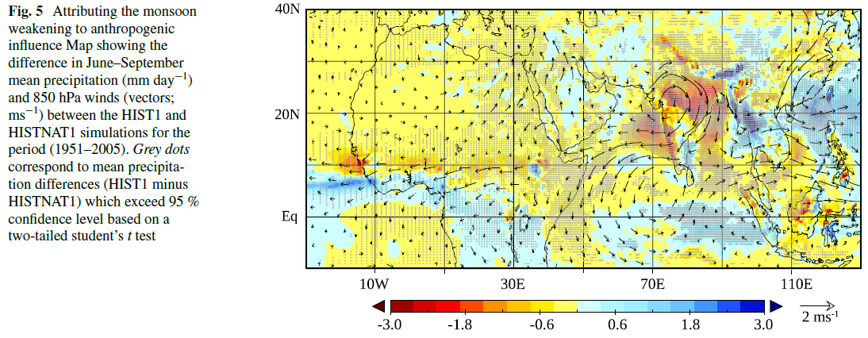
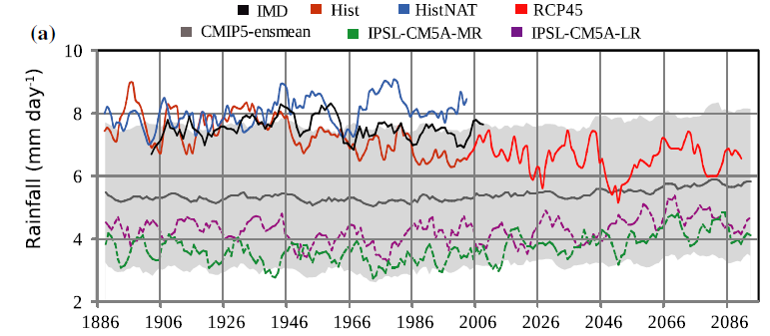
Clim Dyn (2016)
doi:10.1007/s00382-015-2886-5
Climate change simulation experiments using a global model with high-resolution zooming over South Asia demonstrate that regional land-use changes and anthropogenic aerosol-forcing, together with rapid warming of the equatorial Indian Ocean have suppressed the monsoonal rains and promoted precipitation extremes over India in recent decades
Attributing the monsoon weakening to anthropogenic influence
Temporal evolution of
the observed (IMD) and simulated 5-year running mean of seasonal (June–Sept) monsoon precipitation (mm day⁻¹) averaged over land-points in the Indian region
(70°–90°E, 10°–28°N)
Map showing the difference in June-September mean precipitation (mm day⁻¹) and 850 hPa winds (vectors; ms⁻¹) between the Historical (HIST) and Historical-Natural (HISTNAT) simulations for the period (1951-2005). Grey dots correspond to mean precipitation differences (HIST minus HISTNAT) which exceed 95% confidence level based on a two-tailed student’s t-test.

Slide 13
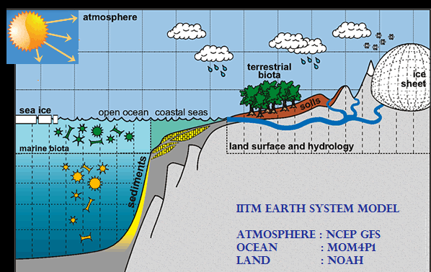
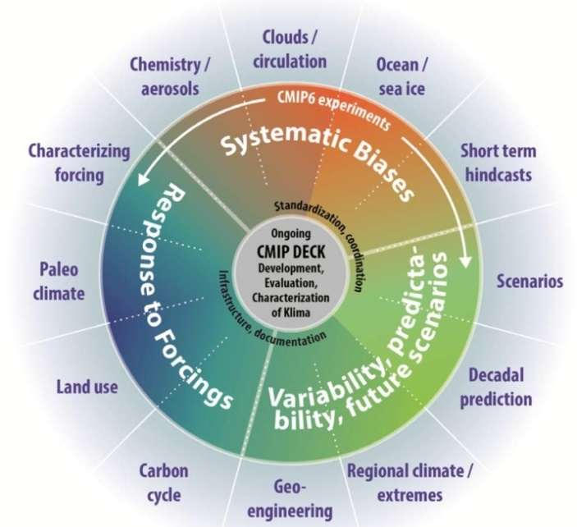
Earth System Modeling Research
The IITM Earth System Model: Transformation of a seasonal prediction model to a long term climate model
Swapna, P., M. Roxy, A. Krishnamurthy, K. Kulkarni, P. Prajeesh, K. Ashok, R. Krishnan, S. Moorthi, A. Kumar and B.N. Goswami , Bull. Amer. Meteorol. Soc., 2015, DOI: 10.1175/BAMS-D-13-00276-1.
Developing a state-of-the-art climate model from India suitable for long-term climate studies is a critical requirement in order to generate reliable future projections of the global and regional climate, and particularly the Indian monsoon rainfall. The Centre for Climate Change Research (CCCR) at the Indian Institute of Tropical Meteorology (IITM) has developed an Earth System Model, IITM-ESM by incorporating earth system components in the Climate Forecast System (CFS) from National Center for Environmental Prediction (NCEP, USA), and thereby transforming the CFS seasonal prediction model to a long-term climate model. The IITM-ESM will be the first climate model from India that will be participating in the Coupled Modeling Intercomparison Project- Phase 6 (CMIP6) experiments required for the Intergovernmental Panel on Climate Change (IPCC) 6th Assessment Report.
http://cccr.tropmet.res.in/home/clim_esm.jsp

Slide 14
The trend modification index (TM) based on Maurer and Pierce 2014) is used to compare the change in seasonal mean (summer monsoon, JJAS, and winter, DJF) precipitation between two historical periods, to examine whether the dynamically downscaled CORDEX RCMs tends to amplify or diminish their driving CMIP5 AOGCM’s simulated precipitation change.
TM = | Δ P_{RCM} - Δ P_{OBS} | - | Δ P_{GCM} - Δ P_{OBS} |
This index have values lesser than 0 where the dynamical downscaling improves the correspondence between the RCM and observed precipitation changes.

Slide 15
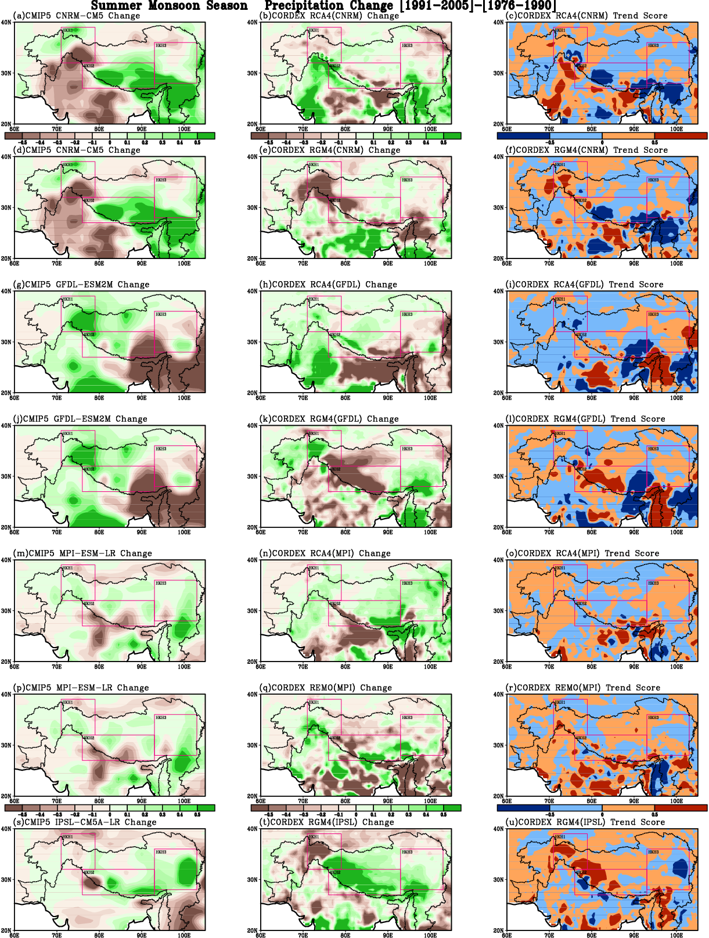
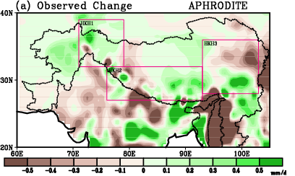
Summer Monsoon Season
Precipitation Change
(1991-2005) - (1976-1990)

Slide 16
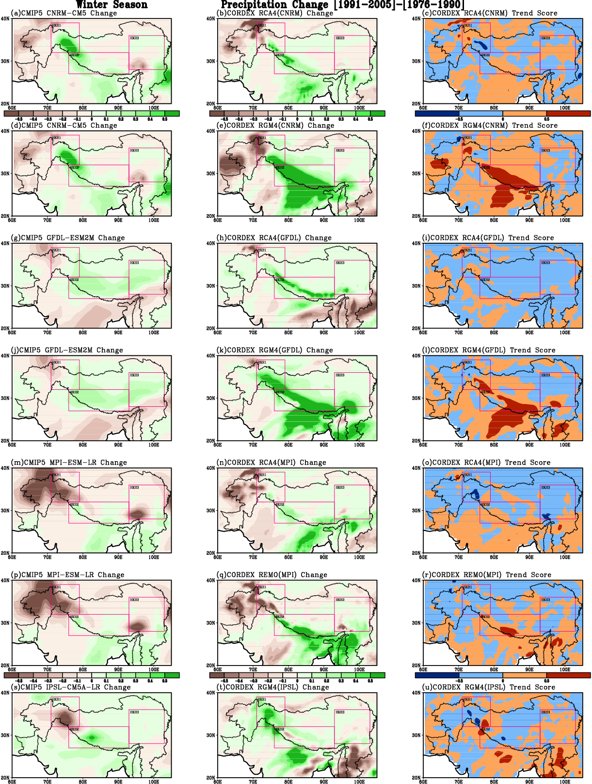
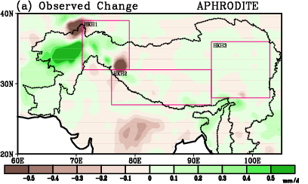
Winter Season
Precipitation Change
(1991-2005) - (1976-1990)

Slide 17
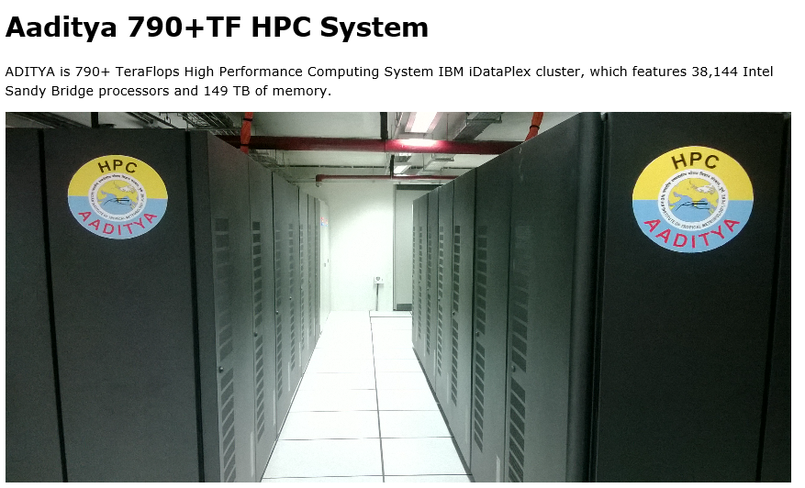
Thanks for your attention
Email: sanjay@tropmet.res.in

